Slide 1

Linnear -Data Structure
Stack
Presentation by:
Anurag Singh

Slide 2

Stack
A stack is a linear data structure in which elements may inserted or deleted from one end called TOP of the stack. In stack the last added element will be first to be removed that’s why it is also called LIFO (Last In First Out) data structure.
Operations on Stack
Push
Pop
Display

Slide 3
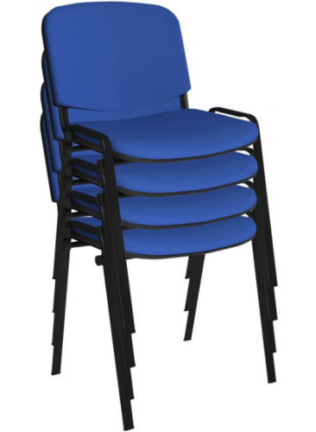

Stack Terminology
LIFO (Last in First out)
TOP
Max Size/ Max Stack
Push
Pop
Stack Overflow
Stack Underflow

Slide 4
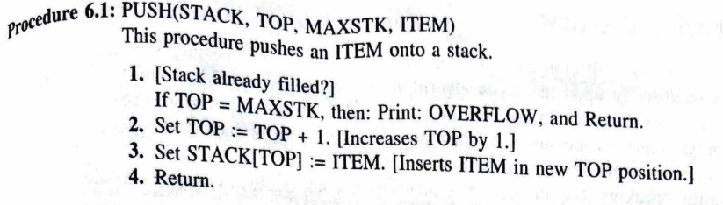
Push operation on Stack
Push Algorithm
STACK OVERFLOW
4
45
TOP
3
33
TOP
2
7
TOP
TOP
1
18
TOP
0
12
TOP
-1

Slide 5
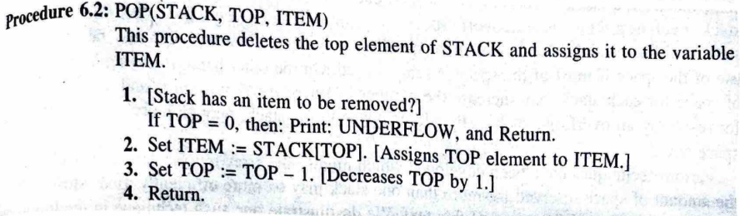
Pop operation on Stack
Push Algorithm
4
45
TOP
3
33
TOP
2
7
TOP
TOP
1
18
TOP
0
12
TOP
-1
STACK UNDERFLOW

Slide 6

Thank you

